Slide 1
Drug Affects on Tumor Growth in Mice

Slide 2
Drug Affects on Tumor Growth in Mice
Raw data taken from 45 days of treatment was analyzed in this project.
100 rows of data was used on 10 mice.
Two data sets were joined which offered the following information:
Mouse ID
Drug Name
Time in Treatment
Tumor Volume (mm3)
Metastatic Sites
Carrie McDowell – Project Analyst

Slide 3
Drug Affects on Tumor Growth in Mice
The following drugs were evaluated
Capomulin | Placebo
Ceftamin | Propriva
Infubinol | Ramicane
Ketapril | Stelasyn
Naftisol | Zoniferol

Slide 4
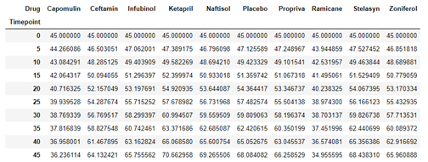
Drug Affects on Tumor Growth in Mice
The Mean Values of the Tumor Size

Slide 5
Drug Affects on Tumor Growth in Mice
Poor Outcome
As seen, the mean tumor volume increased significantly when the drug Ketaprill was used to treat it.
The drugs Naftisol and Stelasyn were not far behind Ketaprill.
Promising Outcome
Two drugs showed promising results. These were Capomulin and Ramicane. Treatment of these drugs reduced the size of the tumor over a coarse of 45 days.

Slide 6
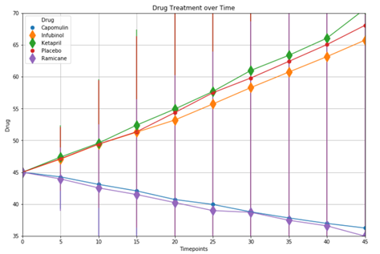
Drug Affects on Tumor Growth in Mice
The Top 5 Drugs Charted

Slide 7
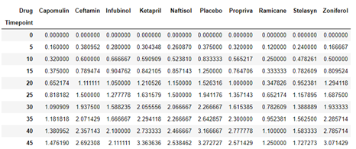
Drug Affects on Tumor Growth in Mice
The Standard Error by Drug

Slide 8
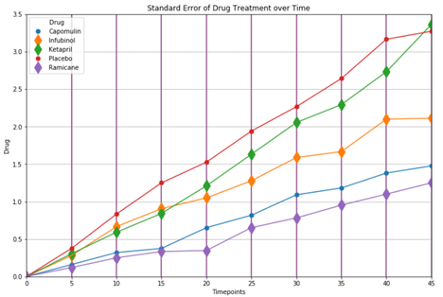
Drug Affects on Tumor Growth in Mice
The Top 5 Drugs Charted

Slide 9
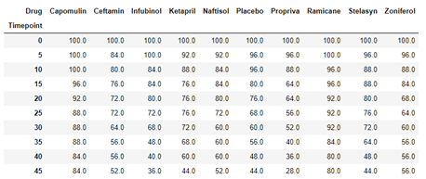
Drug Affects on Tumor Growth in Mice
% Success / Failure over 45 Days

Slide 10
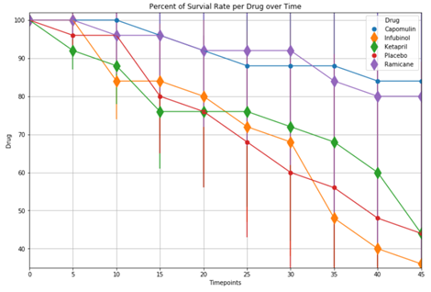
Drug Affects on Tumor Growth in Mice
The Top 5 Drugs Charted

Slide 11
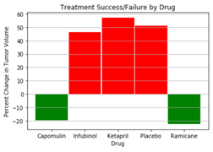
Drug Affects on Tumor Growth in Mice
Conclusion
As seen in the previous slides, the drugs Capomulin and Ramicane had the highest survival rate over a 45 day period.
All other drugs dropped below a survival rate of 50% by day 45

